Slide 1
Public Key Cryptography
Asymmetric Encryption
Part One

Slide 2
Private-Key Cryptography
traditional private/secret/single key cryptography uses one key
shared by both sender and receiver
if this key is disclosed communications are compromised
also is symmetric, parties are equal
hence does not protect sender from receiver forging a message & claiming is sent by sender

Slide 3
Public-Key Cryptography
probably most significant advance in the history of cryptography
uses two keys – a public & a private key
asymmetric since parties are not equal
uses clever application of number theoretic concepts to function
complements rather than replaces private key crypto

Slide 4
Why Public-Key Cryptography?
developed to address two key issues:
  key distribution – how to have secure communications in general without having to trust a KDC with your key
  digital signatures – how to verify a message comes intact from the claimed sender
public invention due to Whitfield Diffie & Martin Hellman at Stanford Uni in 1976
  known earlier in classified community

Slide 5
Public-Key Cryptography
public-key/two-key/asymmetric cryptography involves the use of two keys:
  a public-key, which may be known by anybody, and can be used to encrypt messages, and verify signatures
  a related private-key, known only to the recipient, used to decrypt messages, and sign (create) signatures
infeasible to determine private key from public
is asymmetric because
  those who encrypt messages or verify signatures cannot decrypt messages or create signatures

Slide 6
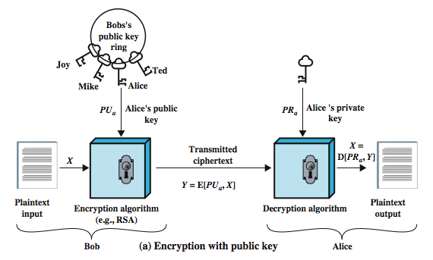
Public-Key Cryptography

Slide 7
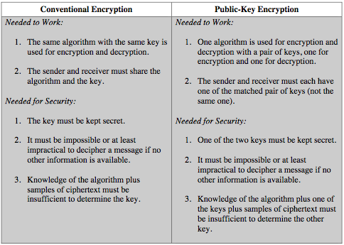
Symmetric vs Public-Key

Slide 8
RSA
by Rivest, Shamir & Adleman of MIT in 1977
best known & widely used public-key scheme
based on exponentiation in a finite (Galois) field over integers modulo a prime
  nb. exponentiation takes O((log n)³) operations (easy)
uses large integers (eg. 1024 bits)
security due to cost of factoring large numbers
  nb. factorization takes O(e ^{log n log log n}) operations (hard)

Slide 9
RSA En/decryption
to encrypt a message M the sender:
  obtains public key of recipient PU={e,n}
  computes: C = Me mod n, where 0≤M<n
to decrypt the ciphertext C the owner:
  uses their private key PR={d,n}
  computes: M = C^{d} mod n
note that the message M must be smaller than the modulus n (block if needed)

Slide 10
RSA Key Setup
each user generates a public/private key pair by:
selecting two large primes at random: p, q
computing their system modulus n=p.q
  note ø(n)=(p-1)(q-1)
selecting at random the encryption key e
  where 1<e<ø(n), gcd(e,ø(n))=1
solve following equation to find decryption key d
  e.d=1 mod ø(n) and 0≤d≤n
publish their public encryption key: PU={e,n}
keep secret private decryption key: PR={d,n}

Slide 11
Diffie-Hellman Key Exchange
first public-key type scheme proposed
by Diffie & Hellman in 1976 along with the exposition of public key concepts
  note: now know that Williamson (UK CESG) secretly proposed the concept in 1970
is a practical method for public exchange of a secret key
used in a number of commercial products

Slide 12
Diffie-Hellman Key Exchange
a public-key distribution scheme
  cannot be used to exchange an arbitrary message
  rather it can establish a common key
  known only to the two participants
value of key depends on the participants (and their private and public key information)
based on exponentiation in a finite (Galois) field (modulo a prime or a polynomial) - easy
security relies on the difficulty of computing discrete logarithms (similar to factoring) – hard

